Slide 1



Welcome to
Presented by: Rebecca Monjaraz

Slide 2

Presentation Topics
VVC is the place to be!
Degrees and Certificates
Enrollment Steps
Student Support Program
VVC Tutoring and Academic Support
Resources and Information

Slide 3



Why Choose VVC?
A.A. degrees and CTE certificates
  Smaller classes, teachers that work closely with students
  Special programs that help you transition more quickly
Location-nearby/Lower Cost Tuition ($46 a unit)
  Near homes and high schools
  Less expensive than UCs or CSUs
Transferring to a four-year college or university
  Transfer from a California Community College to a University of California (UC) or a California State University (CSU) campus

Slide 4

Benefits of attending VVC
Dual enrollment: Adult High School Diploma Program
  Complete High School Diploma program at a faster rate. Class conversion is 3.333 (ex., a 3 unit class at VVC will be 10 credits in a high school program)
Transition from Adult education to college
Flexible schedule
Great Support Programs
Options to transfer or earn a career degree or certificate
Low cost

Slide 5

What Do You Want to Study?
VVC Offers
  Certificates
  Associates of Arts/Science Degrees (AA/AS)
  Associates of Arts/Science for Transfer Degrees (AA-T/AS-T)
https://catalog.vvc.edu/

Slide 6
January-February
February-June
June-August
August-December
Winter (6 weeks)
Spring (16 weeks / 8 weeks)
Summer (6 weeks / 8 weeks)
Fall (16 weeks / 8 weeks)
January 4th - February 13th
February 16 - June 12^{th -}

Slide 7

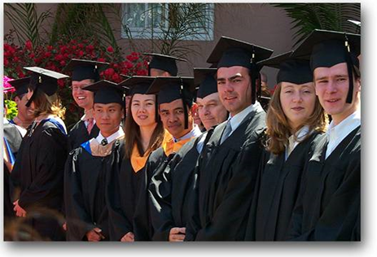
Enrollment Steps for New Students
1. Apply for Admission Online
2. Apply for Financial Aid
3. Set up Webadvisor Account
4. New Student Orientation
5. Take Self Placement
6. See the Counselor for Ed Plan
7. Register for Classes
8. Pay Fees
9. Attend Classes

Slide 8

Step #1: Apply online
www.vvc.edu

Slide 9
Tips for students to complete their Application for Admission using CCCApply.
Legal Name – Students must use their legal name – not nicknames.
SSN – Student should be prepared to enter their SSN
Term Applying for – Winter 2021, Spring 2021…
Academic Goal – Certificate, Associates, Associates and Transfer
Program Major – “Undecided” is NOT AN OPTION
High School Attended – Important to use the drop down menu to select high school. Select your CORRECT ADULT SCHOOL
      Apple Adult School
      Hesperia Adult School
      Lucerne Adult School
      Snowline Adult School
      Victor Valley Adult School
Planning to start VVC after earning high school diploma/GED - enter high school graduate and anticipated graduation date.

Slide 10
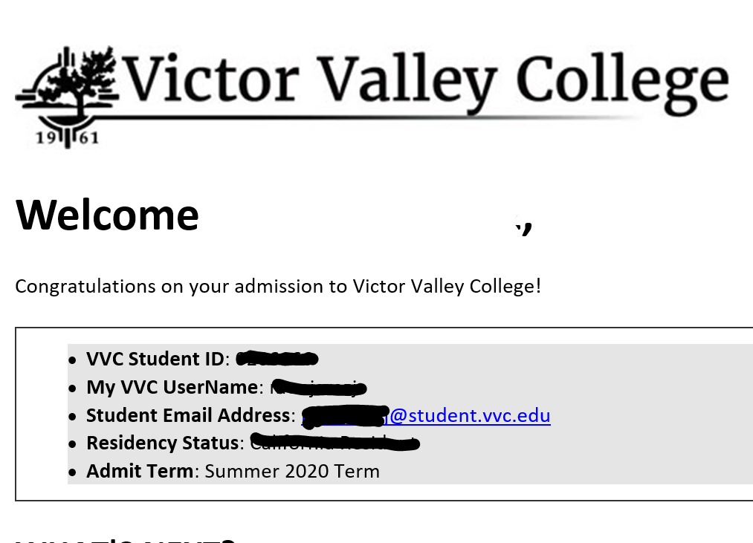

Things to Remember
  (VVC ID Number, Username, Password)
You will receive a welcome email from VVC within 2-3 business days.
VVC Student ID number
WebAdvisor/Canvas Username
Student Email Address
Your Password for WebAdvisor, Canvas, and student email is based on your birthday.
  First three letters of the month with only the First Letter Capitalized.
  Two digit day
  Four digit year
Example: 12/05/97 would result in a password of Dec051997
WHAT'S NEXT?
Login to Navigate (http://www.vvc.edu/navigate) using your "My VVC" User Name and follow the instructions shown. Use Chrome or Firefox as your internet browser. Copy and paste the link if you need to. It will not work on Internet Explorer.
Once logged in you will be guided through the next steps and have access to your student information. Navigate will direct you through enrollment, financial aid, and other resources that will help you succeed at Victor Valley College.

Slide 11

Cost of Attendance
All students pay enrollment fees of $46 per unit
Out of State (Non-Resident students) pay tuition fees of $234 per unit (subject to change)
Total of student fees: About $22 - includes ASB card (free attendance to theater, sports, and some discounts in community), student center fee (used to maintain Student Activites Center), representation fee (provides support for student governmental affairs representation) and student transportation fee (affords VVC students free access to public transportation)
Other: Textbooks, class related materials…

Slide 12
Step 2: Apply For Financial Aid
(Complete your FAFSA or CA Dream Act application)
What is FAFSA?
Free Application for Federal Student Aid
Free application to apply for financial aid for college
Grants
Federal Pell Grant
Federal Work Study
(money students can earn by working on or off campus)
Student Success Completion Grant (SSCG)
California College Promise Grant (CCPG)
Chafee Grants
US Citizen or eligible non-citizen (permanent resident)
Working toward a degree or certificate in an eligible program
Have a valid Social Security Number
***Have a high school diploma or a General Education Development (GED) certificate

Slide 13
California Dream Act Application
-Allows undocumented and nonresident students who qualify for non-resident exemption to receive certain types of financial aid. In addition, the California Dream Act, allows eligible students to pay in-state tuition at any public college in California.
Students need to meet the following California nonresident tuition exemption (commonly known as AB 540):
Attendance for three (3) or more years or the equivalent at any of the combination of the following:
• California high school
• California adult school
• California Community College
OR
• Three (3) years of California high school credits and three (3) years of total attendance in any combination of elementary school, secondary school, or high school in California,
AND
• Graduation from a California high school or the equivalent (GED, HiSET, TASC, CHSPE); or
• Attainment of an associate’s degree from a California Community College; or
• Fulfillment of the minimum transfer requirements from a California Community College to a California State University or University of California campus.

Slide 14
California College Promise Grant
The California College Promise Grant fee waiver is a financial grant given by the government to qualified students in California to help them with the payment of their tuition.
The CCPG waives mandatory enrollment cost per unit.
1 unit= $46
CMST 109: Public Speaking (3 units) | ($138)
ENGL 101: English Composition (4 units) | ($184)
BET 100: Intro to Computers (3 units) | ($138)
GUID 100: Career/Life Planning (2 units) | ($92)
Student Fees: | $22
Total Charges: | $574
CMST 109: Public Speaking (3 units) CA Promise Waiver | ($138) (-$138)
ENGL 101: English Composition (4 units) CA Promise Waiver | ($184) (-$184)
BET 100: Intro to Computers (3 units) CA Promise Waiver | ($138) (-$138)
GUID 100: Career/Life Planning (2 units CA Promise Waiver | ($92) (-$92)
Student Fees: | $22
Total Charges: | $22

Slide 15
2020-2021
Application
Fall 2020
Winter 2021
Spring 2021
Summer 2021
-Application opened October 1st, 2019
-2018 Tax information
2021-2022
Application
Fall 2021
Winter 2022
Spring 2022
Summer 2022
-Application opens October 1st, 2020
-2019 Tax Information
*Complete your is FAFSA every school year
*Opens October 1st

Slide 16
Gathering the Documents Needed to Apply
Your Social Security number (it’s important that you enter it correctly on the FAFSA form!)
Your parents’ Social Security numbers if you are a dependent student
Your driver’s license number if you have one
2018 (AND 2019) Federal tax information or tax returns including IRS W-2 information, for you (and your spouse, if you are married), and for your parents if you are a dependent student:
Records of your untaxed income, such as child support received, interest income, and veterans non-education benefits, for you, and for your parents if you are a dependent student
Information on cash; savings and checking account balances; investments
You are considered a “dependent student” if:
*you are under the age of 24;
*not married;
*do not have children;
*haven’t been in the military;
*not an orphan/ward of the court/foster youth;
*not deemed as homeless

Slide 17
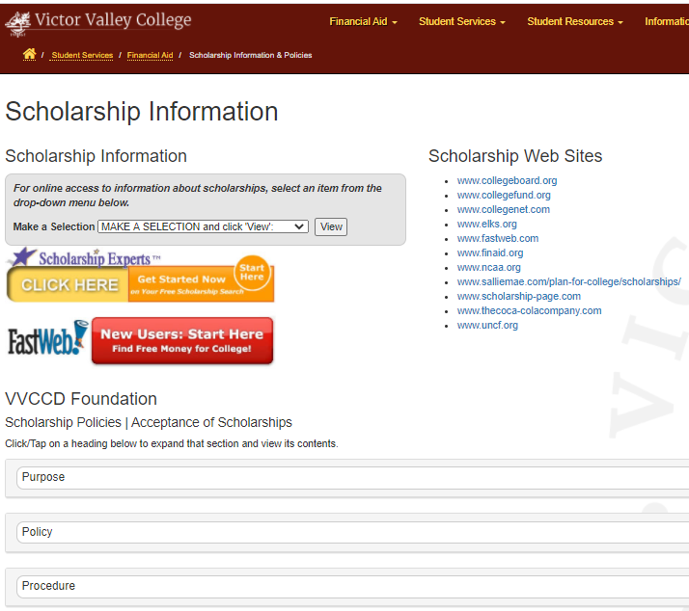
Financial Aid Programs
Scholarships
*Awarded based on a students academic achievement, ethnicity, income, etc and does not have to be repaid.
*Search College’s website, usually listed under Financial Aid
*Search and contact foundations, community organizations and local businesses

Slide 18
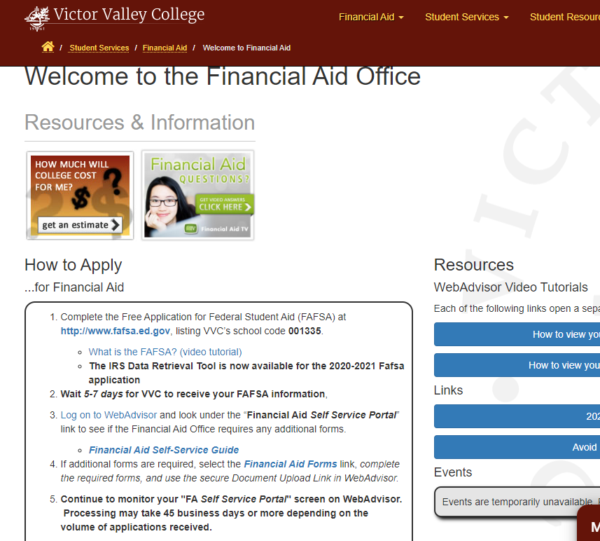
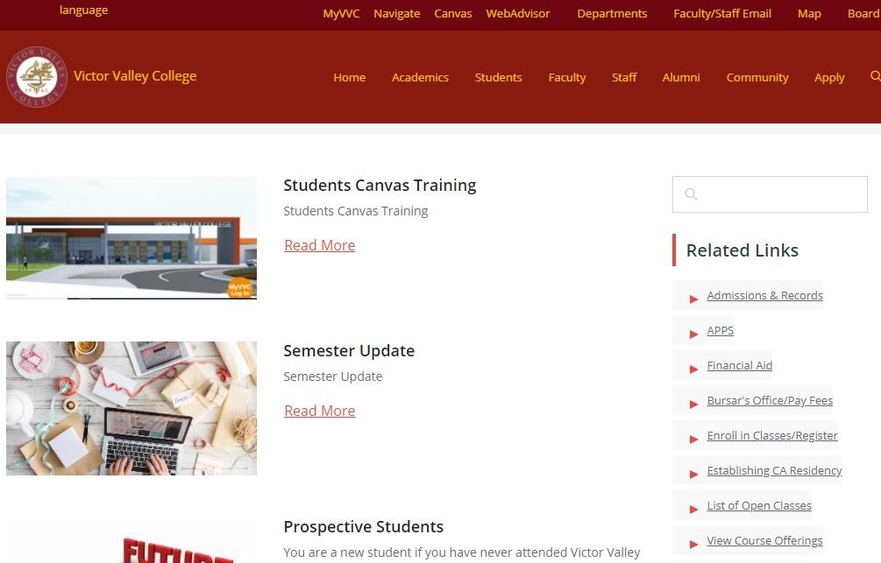
Complete your FAFSA application at fafsa.ed.gov
1. www.vvc.edu
2. Click “Students”
3. Click on “Financial Aid” below “Related Links”
4. Find the “How to Apply” section and click on the first link.

Slide 19
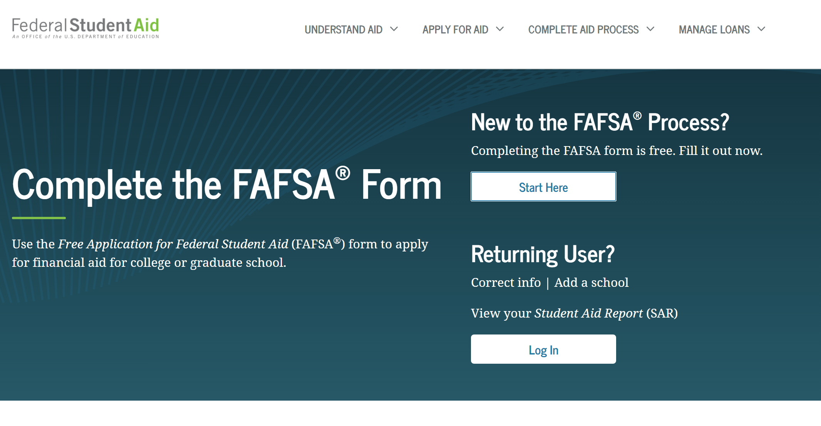
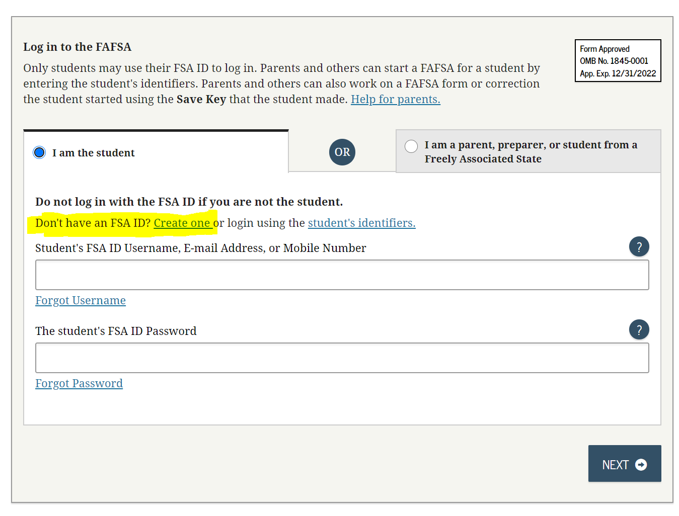
First time applying: Start New
Returning users: Log In
Create your FSA ID Username and Password
Click on “Create One”

Slide 20
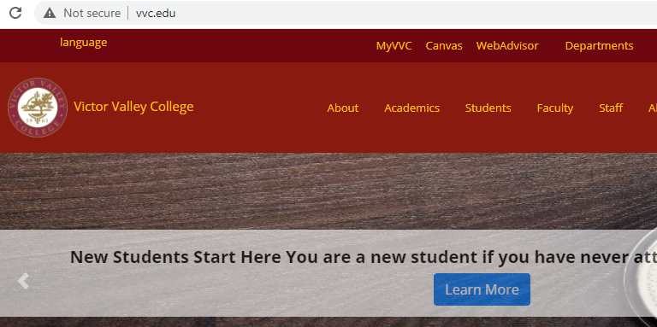
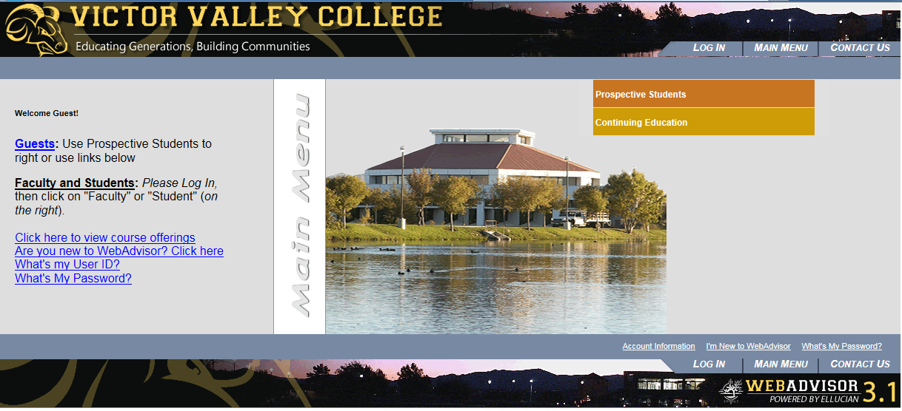
Step 3: Log into your WebAdvisor Account

Slide 21
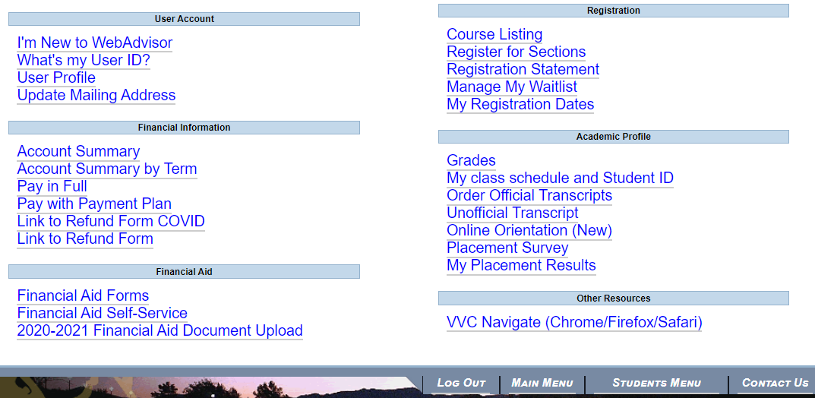
Step 4: View Online Orientation
Step 5: Take Placement Survey

Slide 22
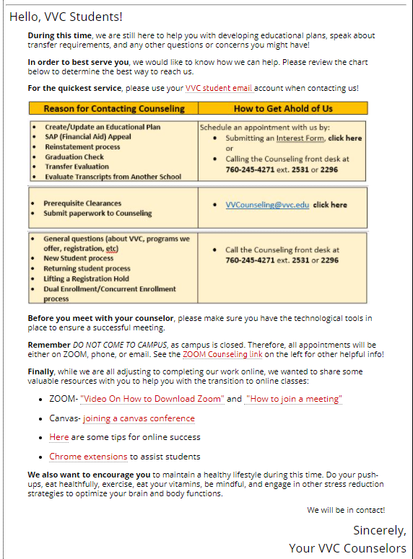

Step 6: Advisement
(Educational Plan)
Make an appointment to meet with your Adult Ed Transitions Counselor REBECCA MONJARAZ to complete your educational plan.
Adult Ed Transitions Counselor
Rebecca.Monjaraz@vvc.edu
760.245.4271 ext. 2489
VVC General Counseling Department.
www.vvc.edu/counseling

Slide 23
VVC Guidance Classes
Guidance 50 – College Success
Guidance 51 – Orientation
Guidance 55 – Building Math Confidence
Guidance 56 – Self-esteem
Guidance 100 – Career/Life Planning
Guidance 101 – First Year Experience
Guidance 105 – Personal/Career Success
Guidance 107 – Learning Strategies

Slide 24
Things to consider…..
When selecting courses each semester, please consider the following:
Course load-How many units will you be taking?
    Full-time student equals 12 units or more
    Part-time student equals less than 12 units
One Unit= 1 hour of class lecture each week
Consider at least two (2) hours of homework/study time per week for each unit you take.
12 units= 12 (hours of class lecture per week)
24 (two hours per unit for homework/study)
36 Total Hours
Course time and frequency of meetings – Morning, Afternoon, Evening; M, MW, T, W, TTH, F, MTWTHF, S
Course type- Remote learning instruction, hybrid (on line and remote learning), online only, or weekend classes

Slide 25
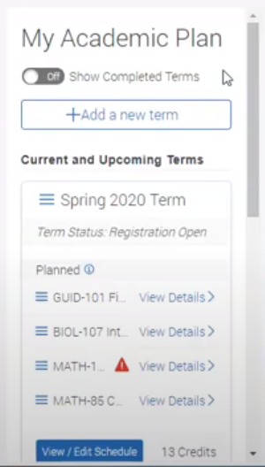
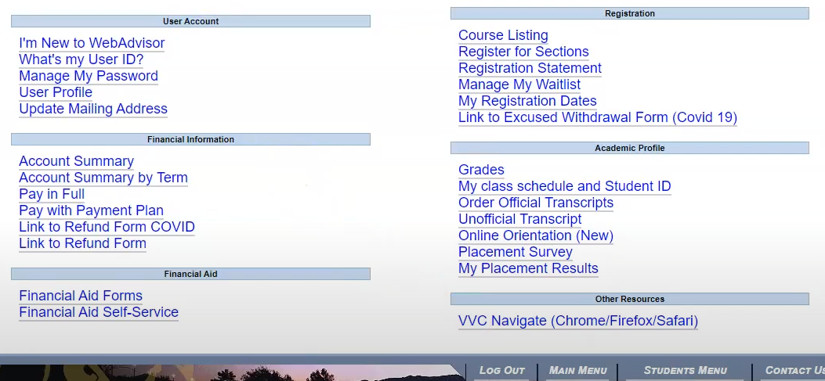
Step 7 : Register for Classes
Open your VVC Navigate to view and approve your educational plan.
Click on “View/Edit Schedule” to register.

Slide 26
Step 8: Pay Fees

Slide 27



Student Services and
Student Support Programs
Admissions and Records
Financial Aid
Counseling
ACCESS
Veterans

Slide 28
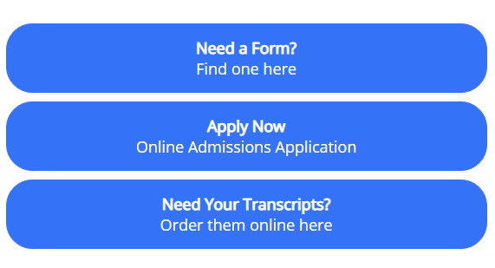
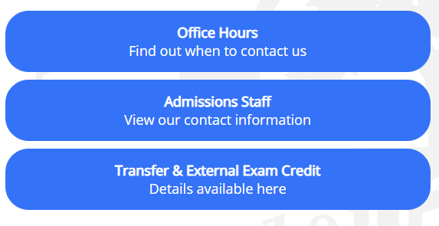
Admissions and Records
The Admissions and Records Office is where students start and finish their educational journey at Victor Valley College. The staff is committed to ensuring that all of our students receive the support and assistance necessary to be successful from the application and registration process all the way through graduation or certificate completion.
Contact:
Phone: 760-245-4271 x. 2272
Email: admissions@vvc.edu

Slide 29
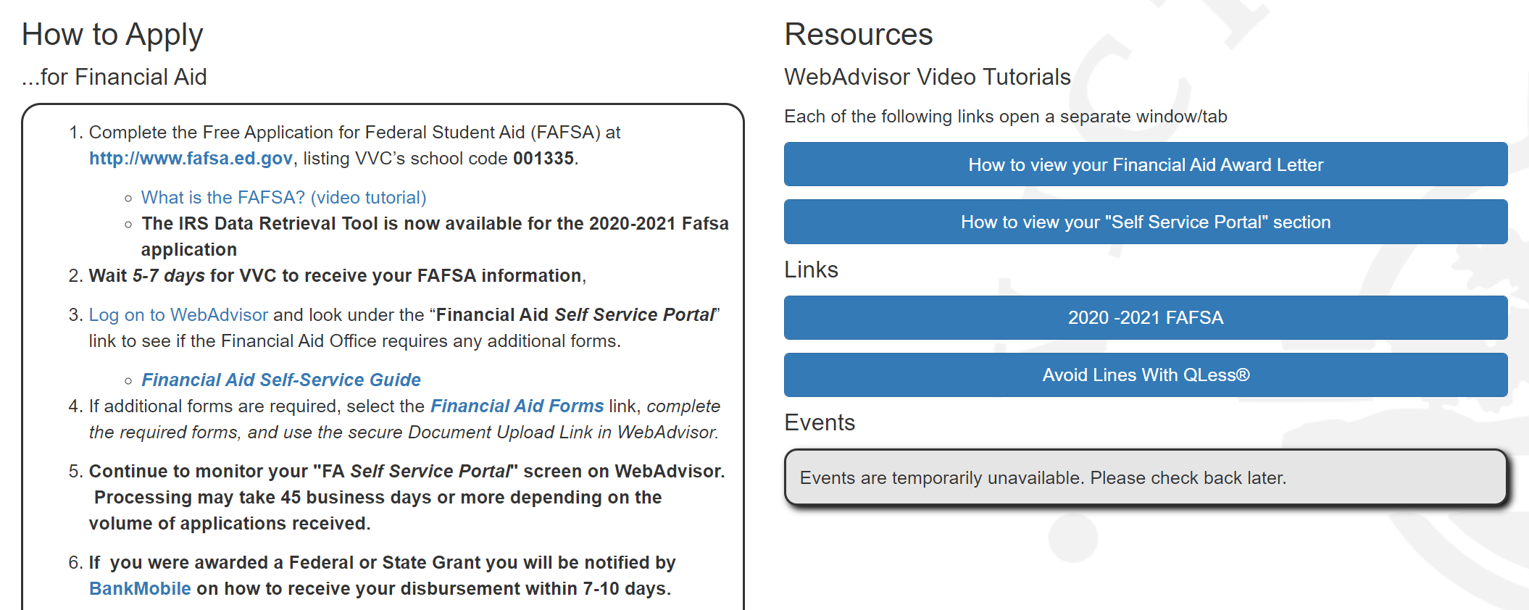
Financial Aid Office
Information regarding…
Student Budgets
Financial Aid Forms
FAFSA Application assistance and information
California College Promise Grant
Cal Grant Information
Federal Work Study Program
Scholarship Information and Policies
Disbursement Schedule
BankMobile
Satisfactory Academic Progress (SAP) Information
SAP appeals
Contact:
Phone: (760) 245-4271, ext. 2277
Email: FinancialAid@vvc.edu

Slide 30
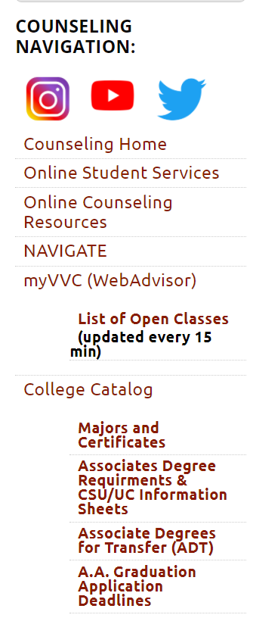
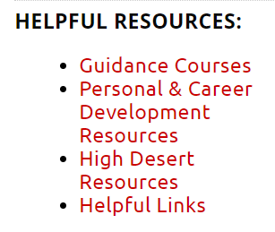
VVC General Counseling Department
www.vvc.edu/counseling
Contact:
Phone: (760) 245-4271, ext. 2531 or 2296
Email: vvcounseling@vvc.edu

Slide 31
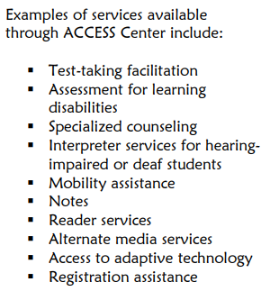

ACCESS
Download Application and Brochure online
WHAT DOES ACCESS DO
  Provide services to students who have one or more disabilities affecting them in their educational environment.
  Provides a variety of support and academic accommodations to assist students in successfully completing their academic goals.
ELIGIBILITY REQUIRMENTS
  To be eligible for the program, you must have a disability verified by a physician, psychologist or other appropriate professional.
  If you have a learning disability, you should bring copies of your test scores.
  Students who believe they may have a learning disability may be tested.
Contact:
Phone: 760-245-4271 ext. 2212
Email: access@vvc.edu

Slide 32
E.O.P.S. /C.A.R.E.
What is C.A.R.E. ?
The C.A.R.E. Program is funded by the State of California and is an educational support program for single parents.
TO QUALIFY FOR C.A.R.E., YOU MUST...
Be eligible and active with E.O.P.S.
Be enrolled in 12 or more units.
Be considered single and/or head of household by AFDC or TANF.
Be a recipient of AFDC or TANF
Have at least one child under age fourteen(14).
C.A.R.E. OFFERS...
Services: Book Voucher, Parking Voucher, Food/Gas Card. Transportation Grant.
Referrals: Campus & Community
Liaison: With on/off-campus agencies, including AFDC and TANF
Support Programs: Group meetings
What is the Purpose of E.O.P.S. ?
The purpose of E.O.P.S. is to encourage the enrollment and retention of students who are educationally and financially disadvantaged. E.O.P.S. will assist these students in successfully completing a vocational certificate, an AA/AS degree, or in transferring to a four-year college or university.
Who is Eligible for E.O.P.S.?
A student who:
is a California resident.
2. is educationally disadvantaged (determined by the Victor Valley College Assessment Test).
3. has applied for financial aid
4. is eligible for BOGW A or BOGW B
5. is enrolled in 12 or more units in the Spring or in the Fall semester (not required if you are a DSPS student).
6. has not received an Associates Degree (AA/AS) or completed more than 70 degree applicable units from any other college, including Victor Valley College
E.O.P.S. provides:
Book Service, Counseling, Orientation, Priority Registration, Student Assistance, Transferring Assistance, and Referrals.
Contact:
Phone: 760-245-4271 ext. 2422
Email: EOPS@vvc.edu

Slide 33
CalWorks
What is CalWORKs?
California Work Opportunity and Responsibility to Kids is a state-funded welfare-to-work program designed to help individuals on public assistance.
Who is Eligible for CalWORKs?
To qualify for the CalWORKs Program you must meet the requirements:
A person receiving cash aide for themselves and their family. (TANF formerly known as AFDC)
Must have completed Admissions and Assessment to Victor Valley College.
CalWORKs Supportive Services
Advocacy
Academic, Career and Personal Counseling
County Ed Plans
Student Center and Rep Fee
Work Study and Job Placement
Supplies (notebooks, pens pencils etc.)
Contact:
Phone: 760-245-4271 ext. 2592
Email: tracey.downing@vvc.edu

Slide 34

NextUp
Who is Eligible for NextUp
  California resident
  Applied for Financial Aid & qualify for CCPGW (CA Promise Grant)
  In foster care on or after16th birthday
  Under 26 years old
  Enrolled in at least 9 units (6 units for students with ACCESS)
As a NextUp student, you may receive:
One-on-one counseling with a counselor to support and address personal, academic and career needs
Hands-on guidance and assistance from application through certificate or degree completion and/or transfer
Specialized workshops such as Life Skills development, Financial Literacy, Coping Skills, ect.
Financial Support (meal vouchers, transportation assistance, childcare, student fees, emergency housing, etc.)
Academic support (textbooks, tutoring, educational supplies, etc.)
Priority registration
Referrals for on-campus and off-campus resources
Students who were in PROBATION, INCARCERATED, or in FOSTER CARE between the ages of 16 and 18 then you may qualify.
Contact:
Phone:760-245-4271 ext. 2929
Email: vvcnextup@gmail.com
Text: 760-515-9025

Slide 35
Puente
Puente is an academic, counseling and mentoring program of support for students to build the skills necessary for success in both academic and career goals. Students in Puente work closely with their counselor, English instructor and MENTOR to prepare for transfer to four-year colleges and universities.
HOW DO YOU QUALIFY?
Be committed to taking ENGL 101 & GUID 101 in Fall
Be committed to taking ENGL 104 & GUID 107 in Spring
Have a desire to transfer to a four-year college or university
Enroll in no more than 14 units, each semester, during the first year
WHAT DO WE OFFER?
English and Guidance classes dedicated to Puente students only
Ongoing academic and career counseling until transfer
Mentoring, internship and community service opportunities
FOR MORE INFORMATION:
Complete a Student Interest Form (online)
Email: Richard.Alvarez@vvc.edu

Slide 36
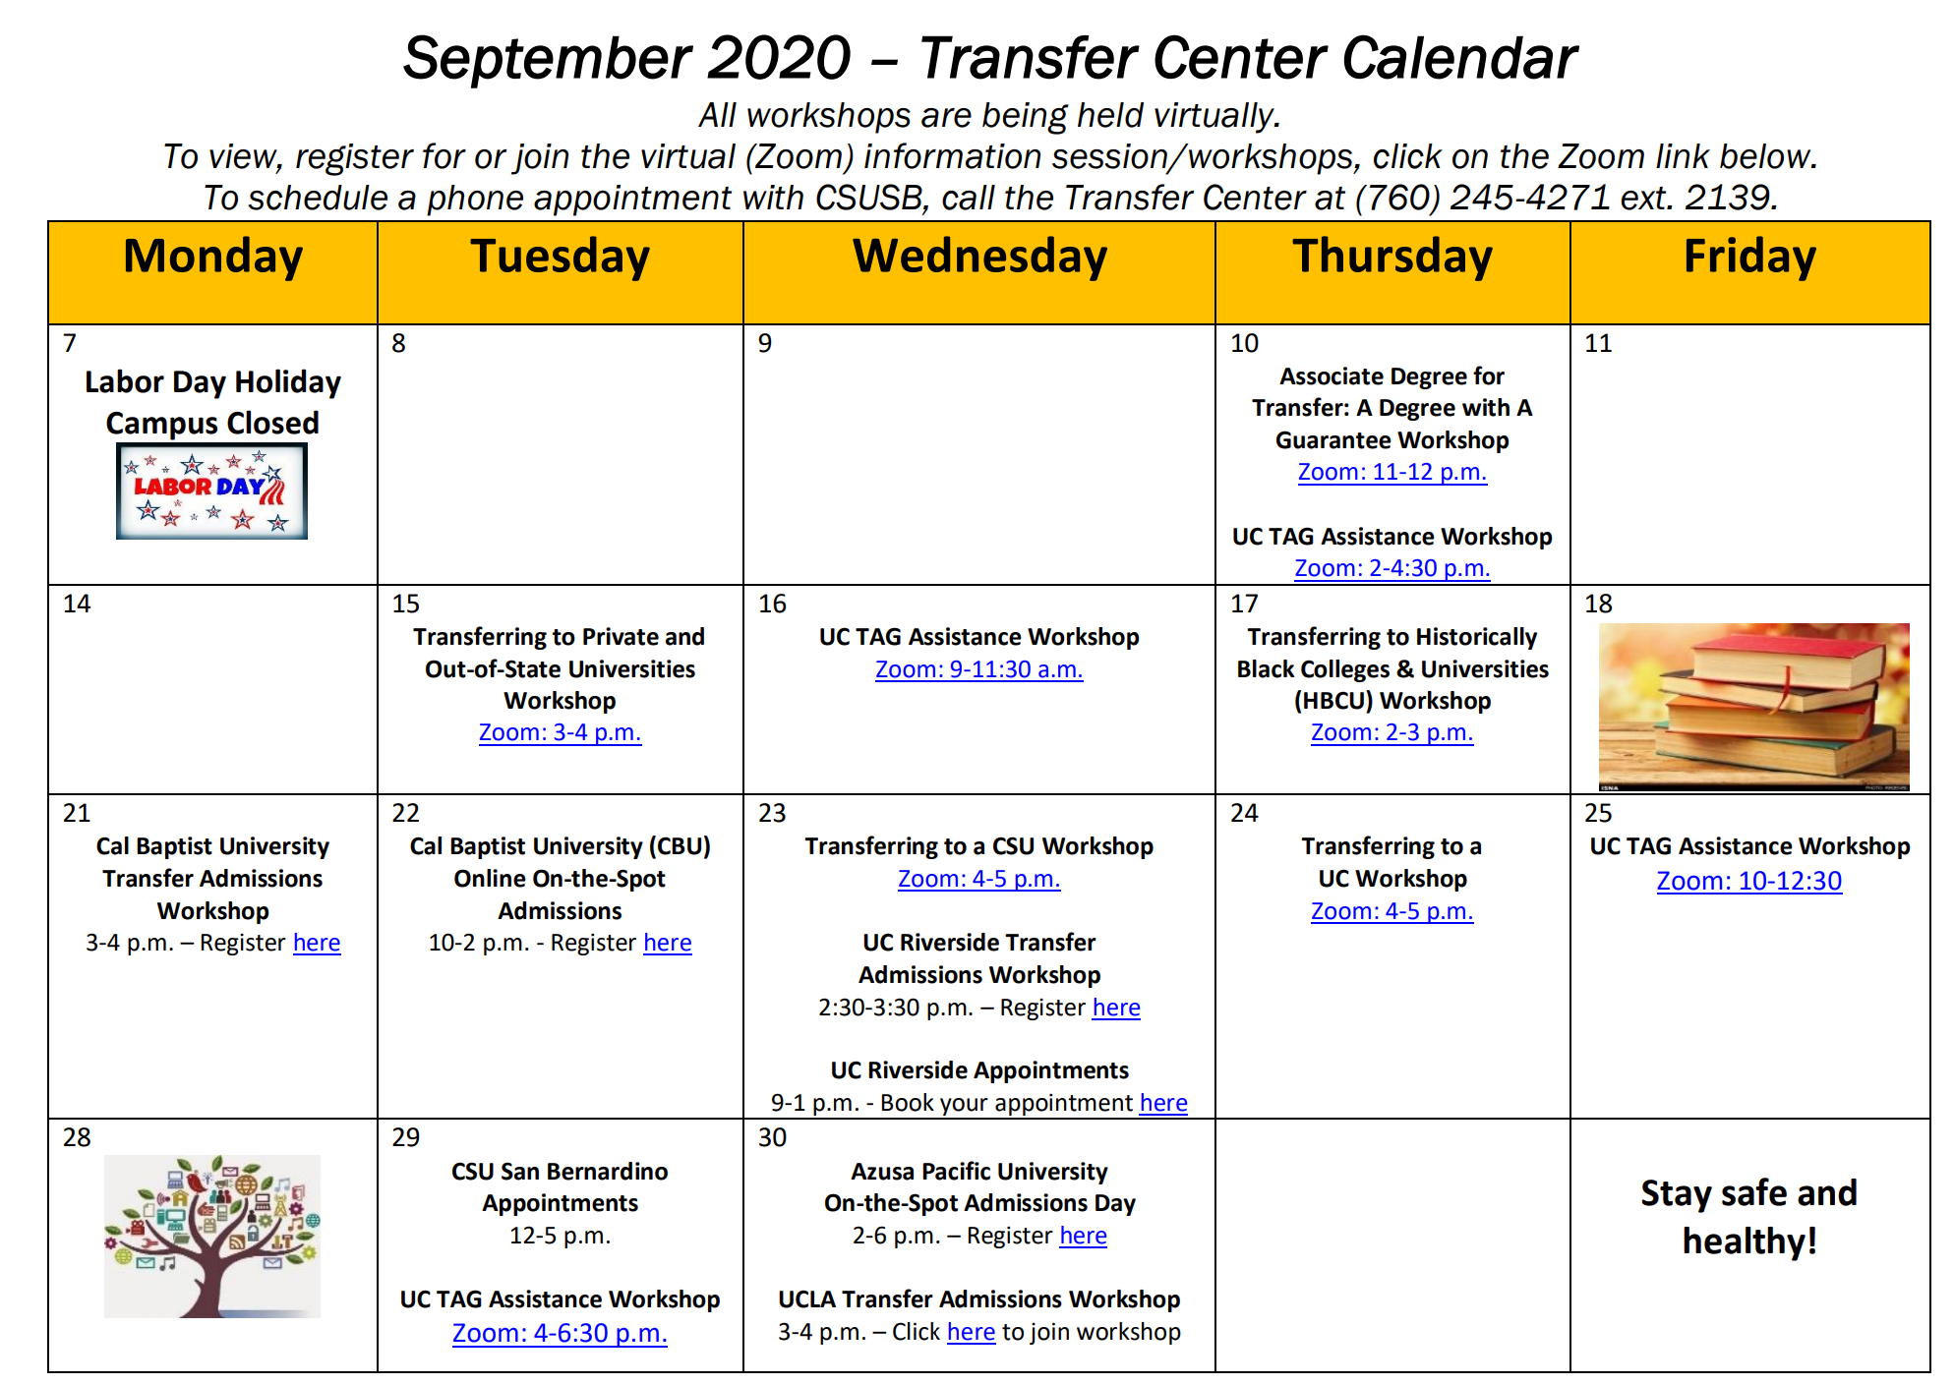
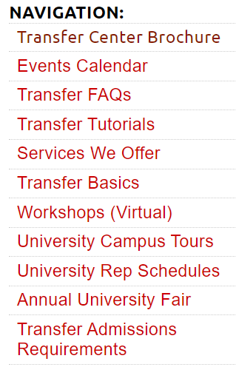
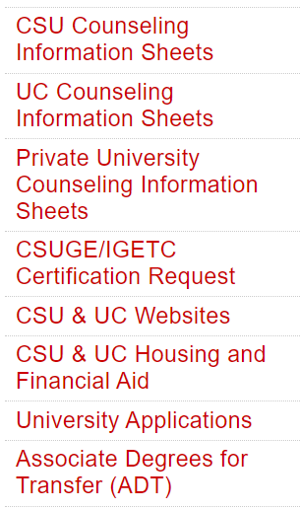
Transfer Center
Receive text messages about transfer events/activities.
Text @vvctransf to this number: 81010
Contact:
Phone: 760-245-4271 ext. 2139
Email: tansfer@vvc.edu

Slide 37

Veterans Resource Center
Victor Valley College welcomes all student veterans, active duty military members, and VA dependents with varying educational goals.
Counseling & Tutoring Services have moved to an online platform
Academic Counseling
Computer Lab
GI Bill® Applications/Process
Quiet Study Environment
VVC Enrollment Assistance
Guest Speakers/Orientations
Copier/Printer Available
Financial Aid Assistance
Wi-Fi
Small Library
Friendly VA Work-Study Staff
Veterans Literature
Tutoring Services Available
Contact:
Phone: (760) 245-4271 extension 2245
Email: Va.gibill@vvc.edu
For VA related questions go to:
https://www.va.gov/

Slide 38

Tutoring and Academic Support
Victor Valley College has created a network of Student Success Centers — which offers free tutorials, workshops, and resource access — to assist students in their academic development and success.
Online Tutoring Support
All tutoring normally conducted in the Athletics Center, Communication Center, Math Success Center, Tutoring and Academic Support Center, Veteran’s Resource Center, and the Writing Center can now be accessed in Canvas through the Tutoring and Academic Support tab.
https://cccconfer.zoom.us/recording/play/oBSt_vcy37W3ZRrFi62JqTc153ehSpwpKvLhQ_ZpX9j4iRhwbXtjJWNf8IacaWQS?autoplay=true

Slide 39
Resources
and Information

Slide 40
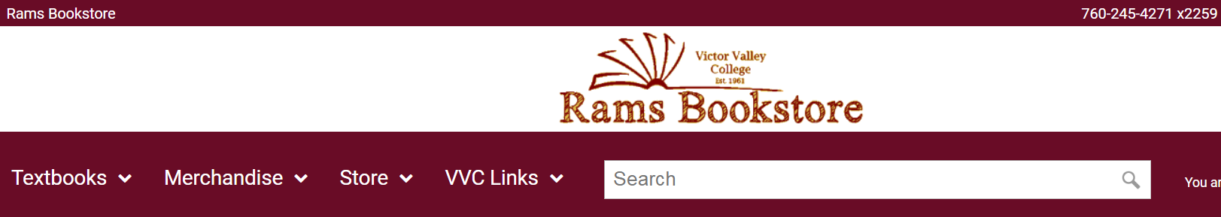
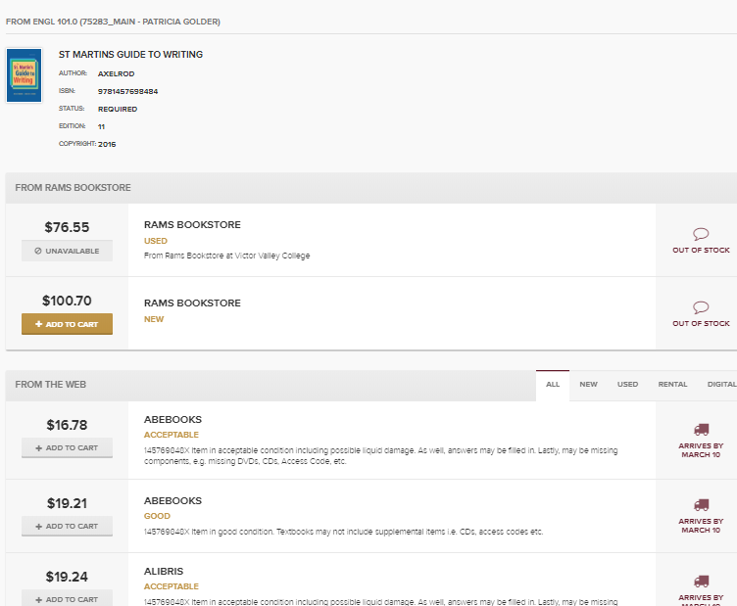
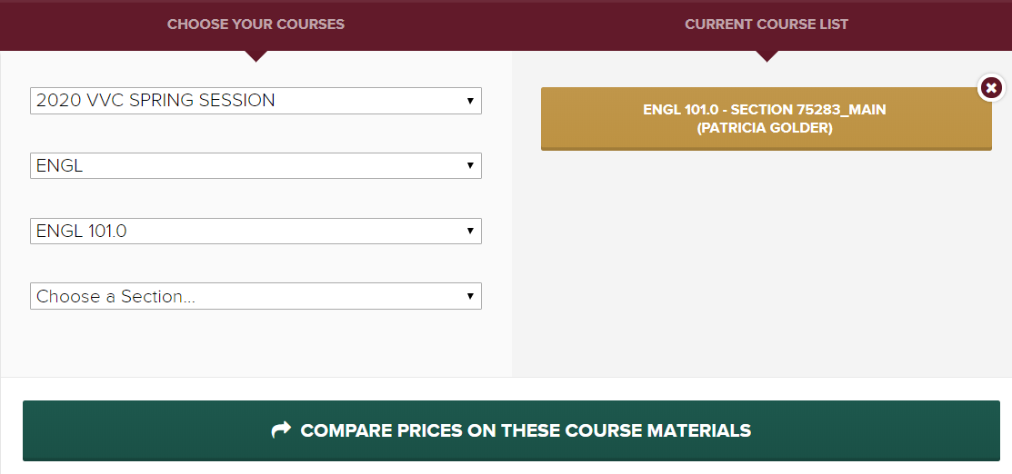
Textbooks
vvcRams.com
  OER
  Open Educational Resources

Slide 41
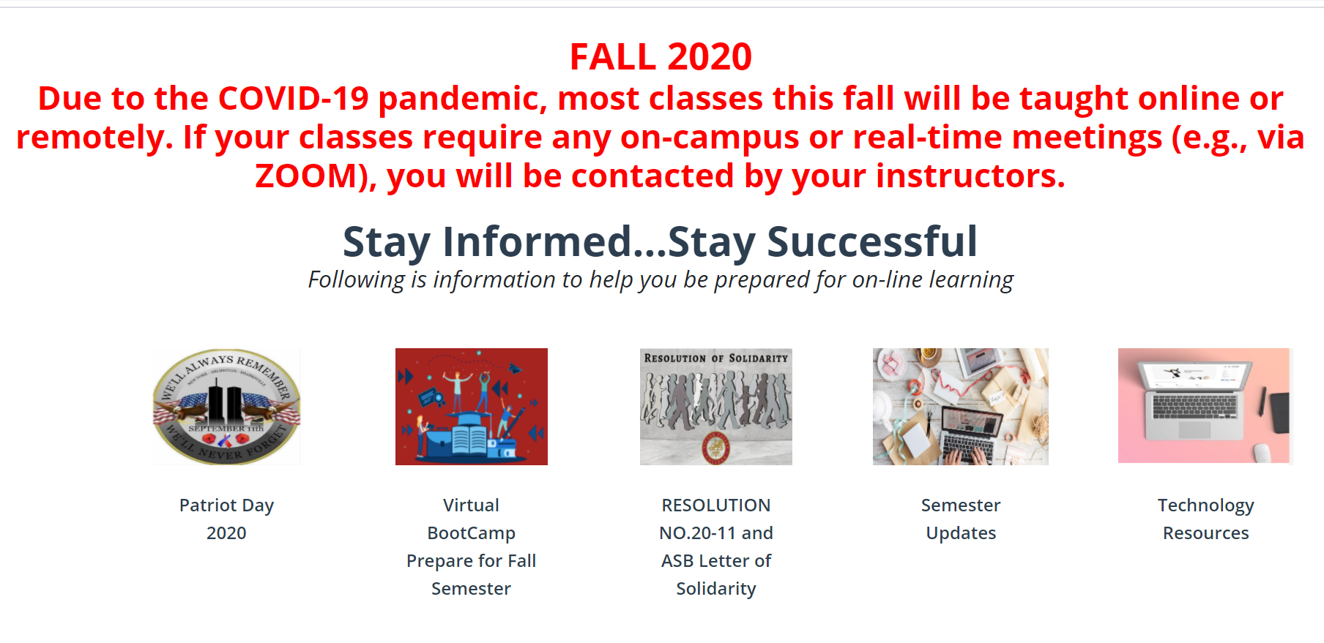
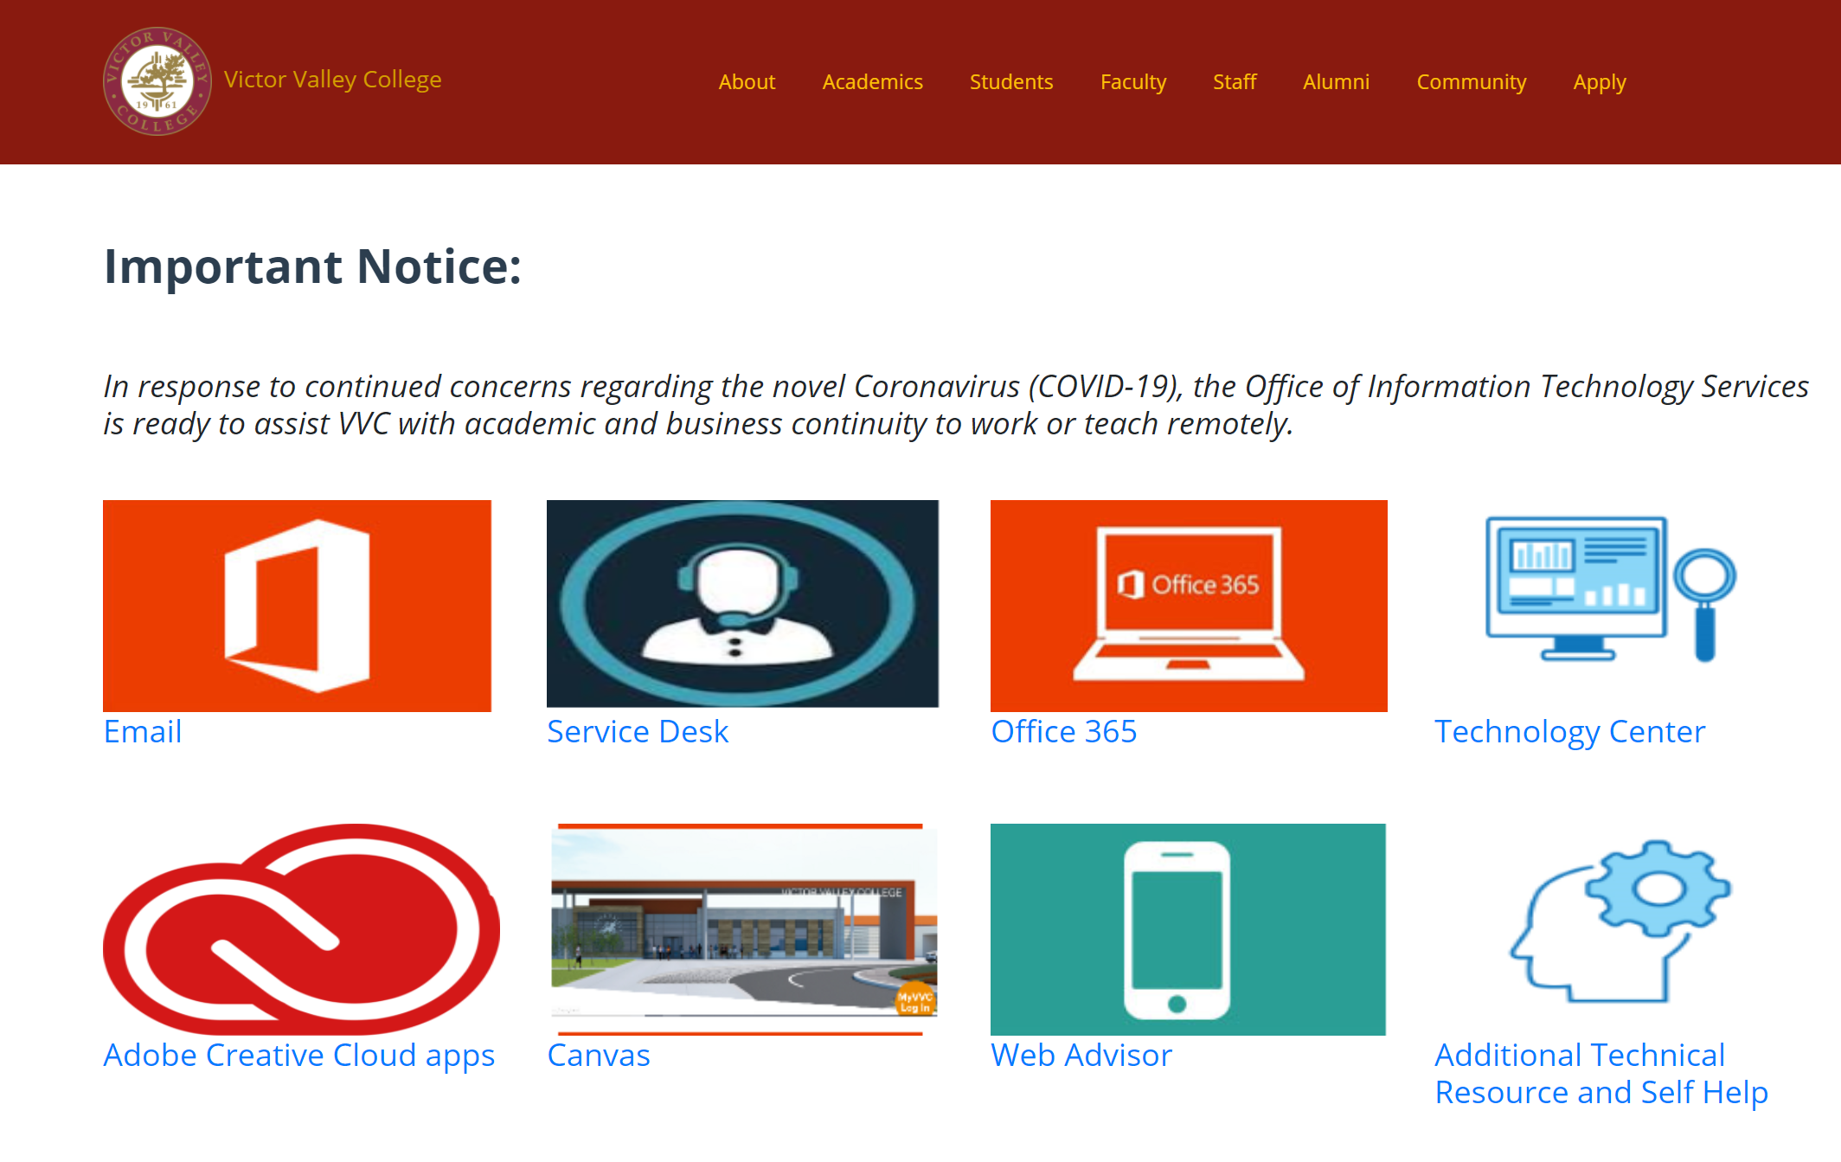
vvc.edu
Technology Resources
Set-Up Student Email
Service Desk
Office 365
Technology Center
Adobe Creative Cloud Apps
Canvas
WebAdvisor
Additional Technical Resources
and Self Help

Slide 42
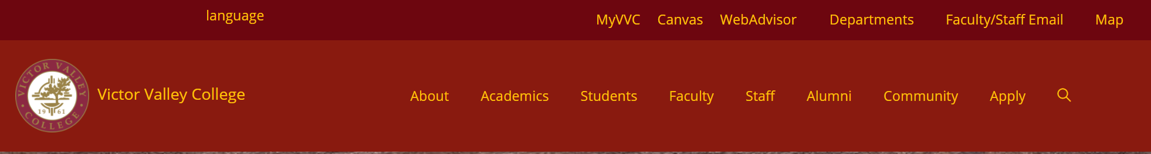
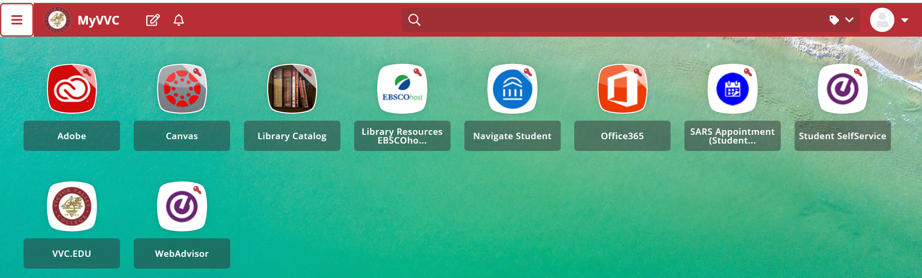
MyVVC

Slide 43
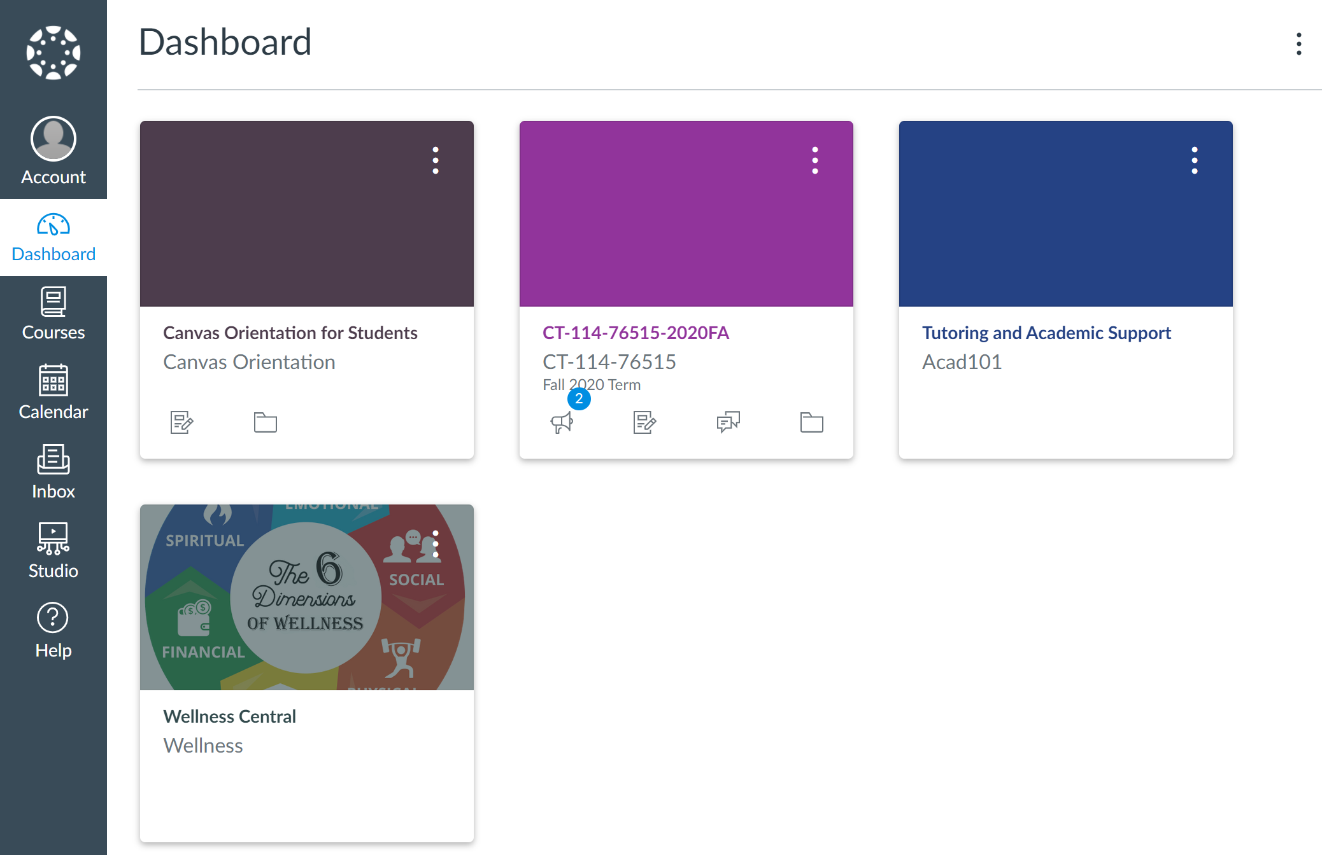
CANVAS

Slide 44
*STUDENT ID CARD
1. Printout Registration Statement
2. Schedule an appointment
Call 760-245-4271
ext. 2278 or 2395
WebAdvisor

Slide 45

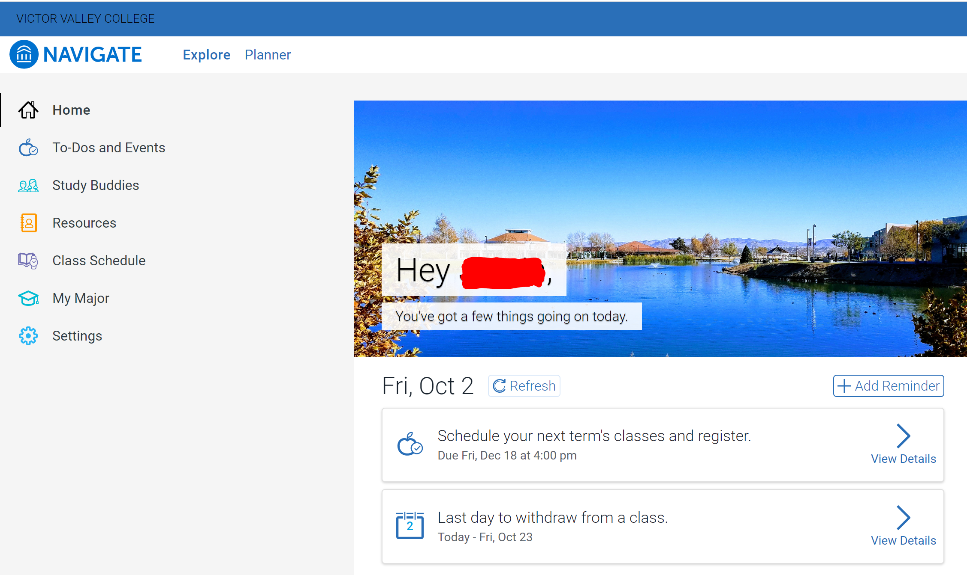
NAVIGATE

Slide 46
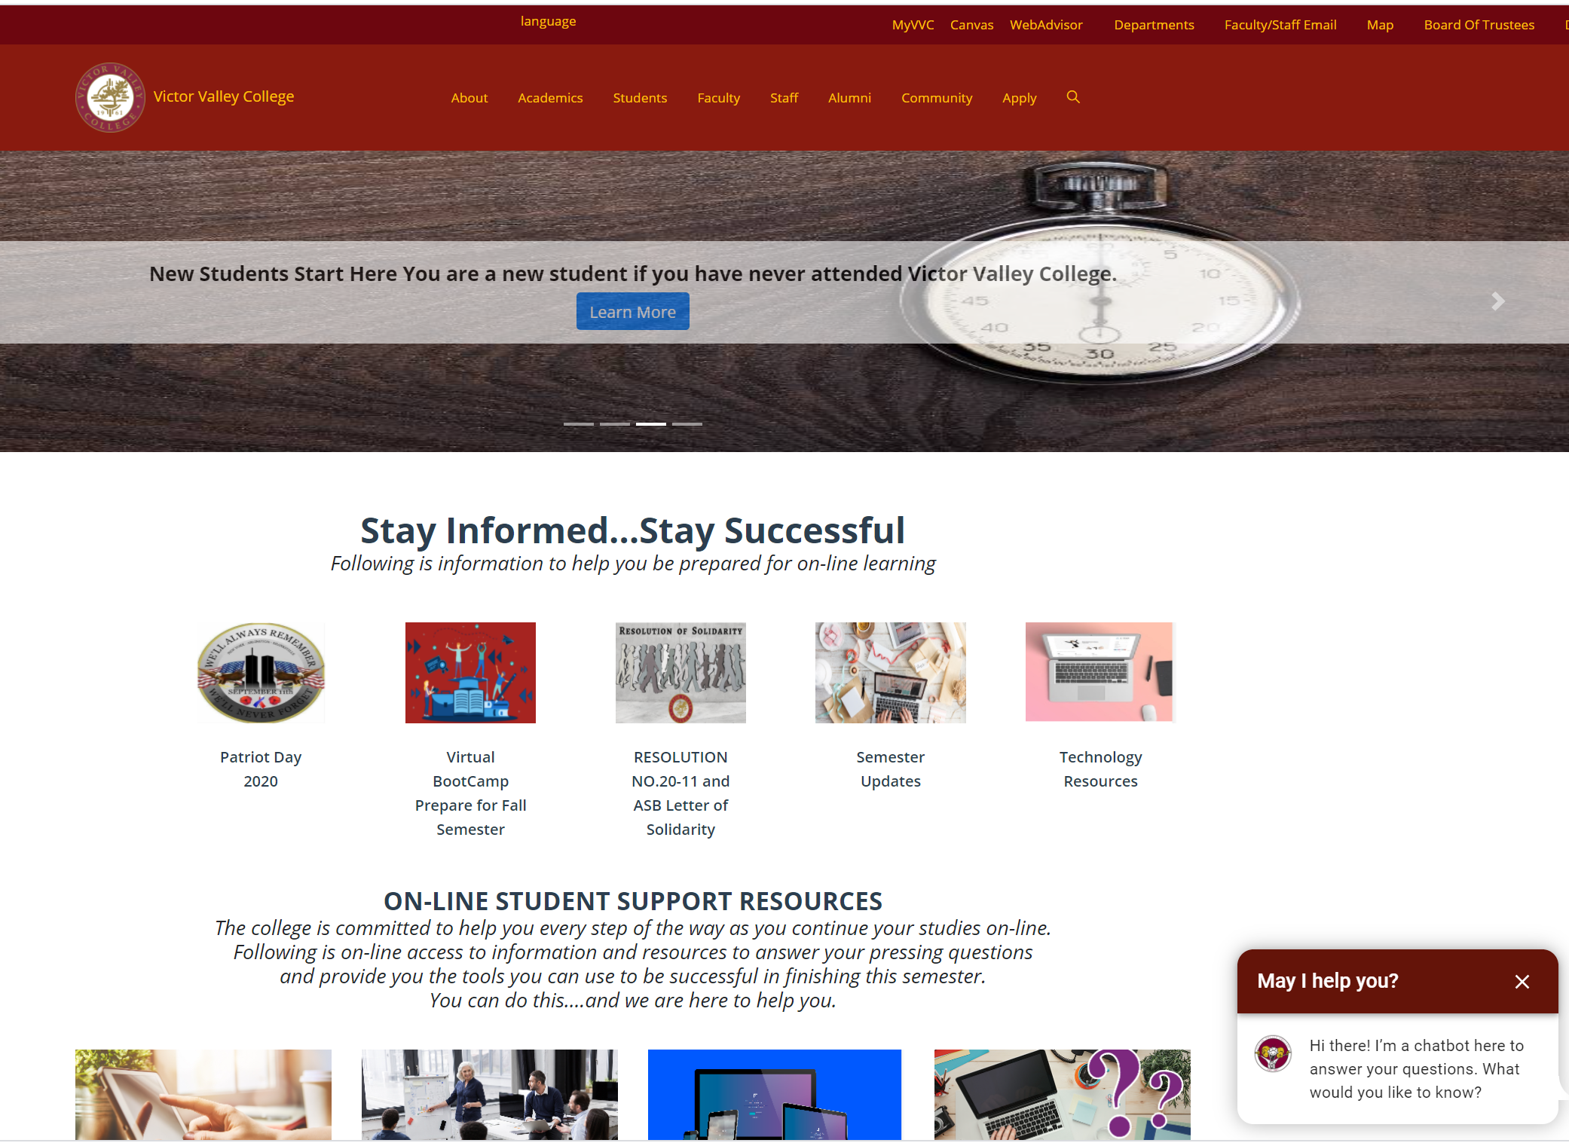
vvc.edu

Slide 47
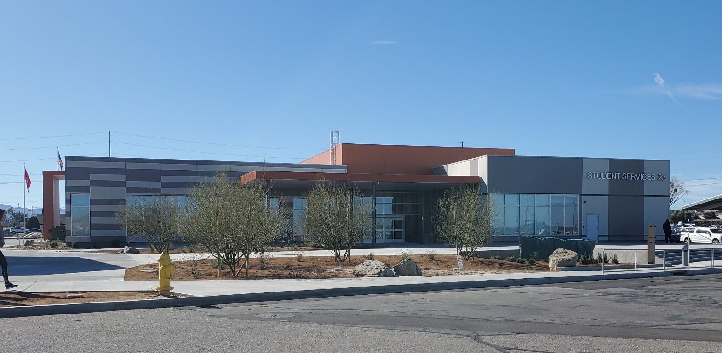
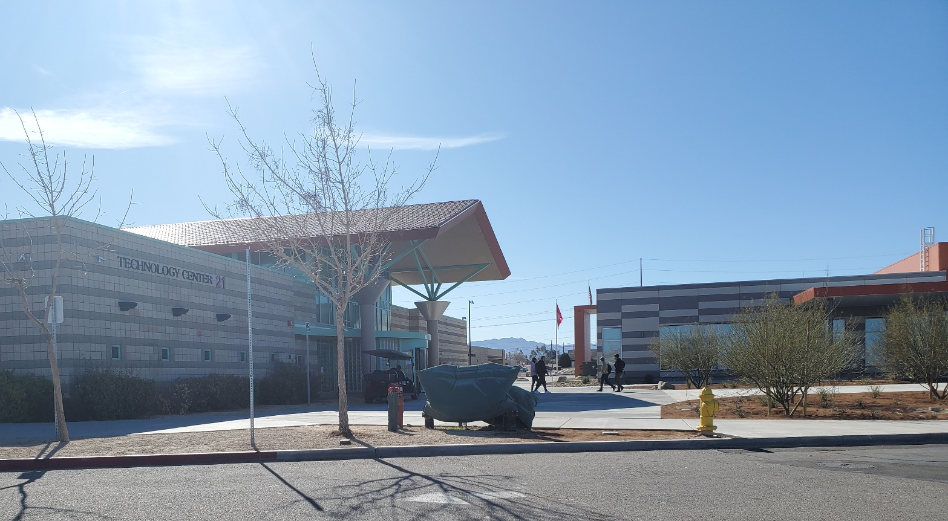
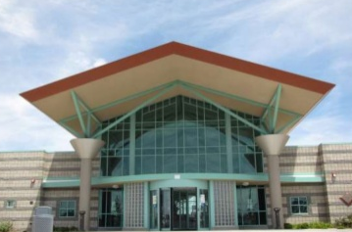
Student Services Center
Building 23
Technology Center
Building 21

Slide 48

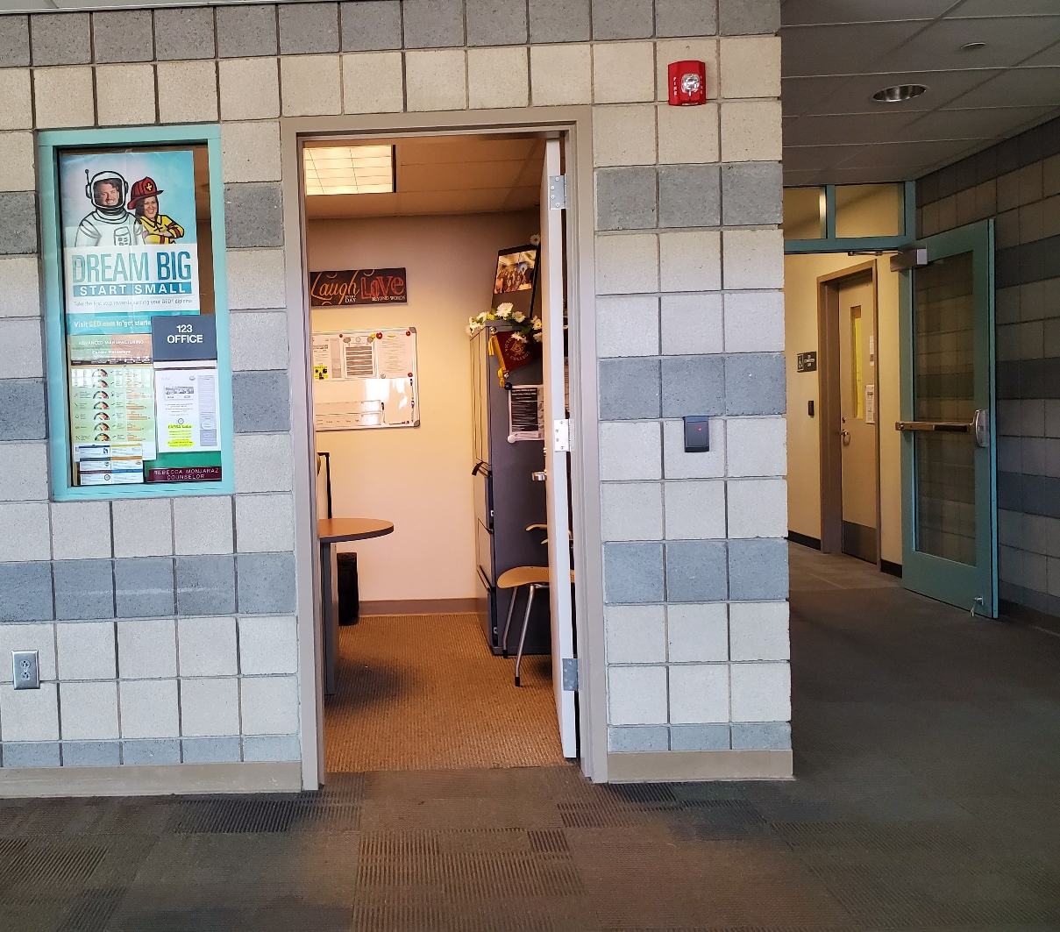
  Transition Counselor for Adult Education
  Rebecca Monjaraz
  Rebecca.Monjaraz@vvc.edu
  760-245-4271 x2489

Slide 49
QUESTIONS,
please contact:
  Transition Counselor for Adult Education
  Rebecca Monjaraz
  Rebecca.Monjaraz@vvc.edu
  760-245-4271 x2489

